Slide 1
Soft skills for engineers
Unit - i
Presented By:
Mr. Kartikain Shivam

Slide 2
Course Content
Introduction to Soft Skills and its Significance
Importance of Grooming
Interpersonal Communication
Adaptability
Time Management
Teamwork

Slide 3
Introduction
Soft Skills include attributes and personality traits that help employees interact with others and succeed in the workplace.
E.G.: the ability to communicate with:
prospective clients
mentor your co-workers
lead a team
negotiate a contract
follow instructions
and get a job done on time.

Slide 4
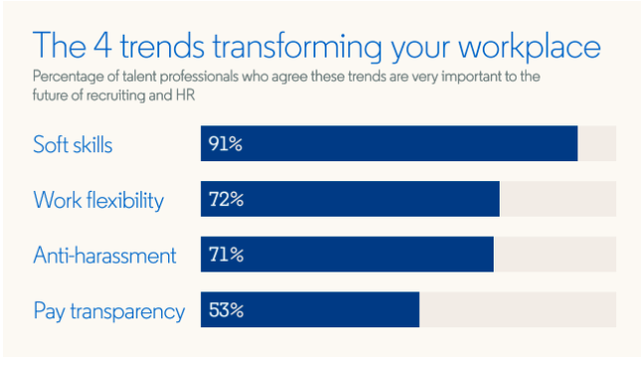
Significance of soft skills
How well you interact with others is crucial for career success.
Trust develops through positive interactions and relationships, and productivity increases in environments where soft skills flourish.

Slide 5
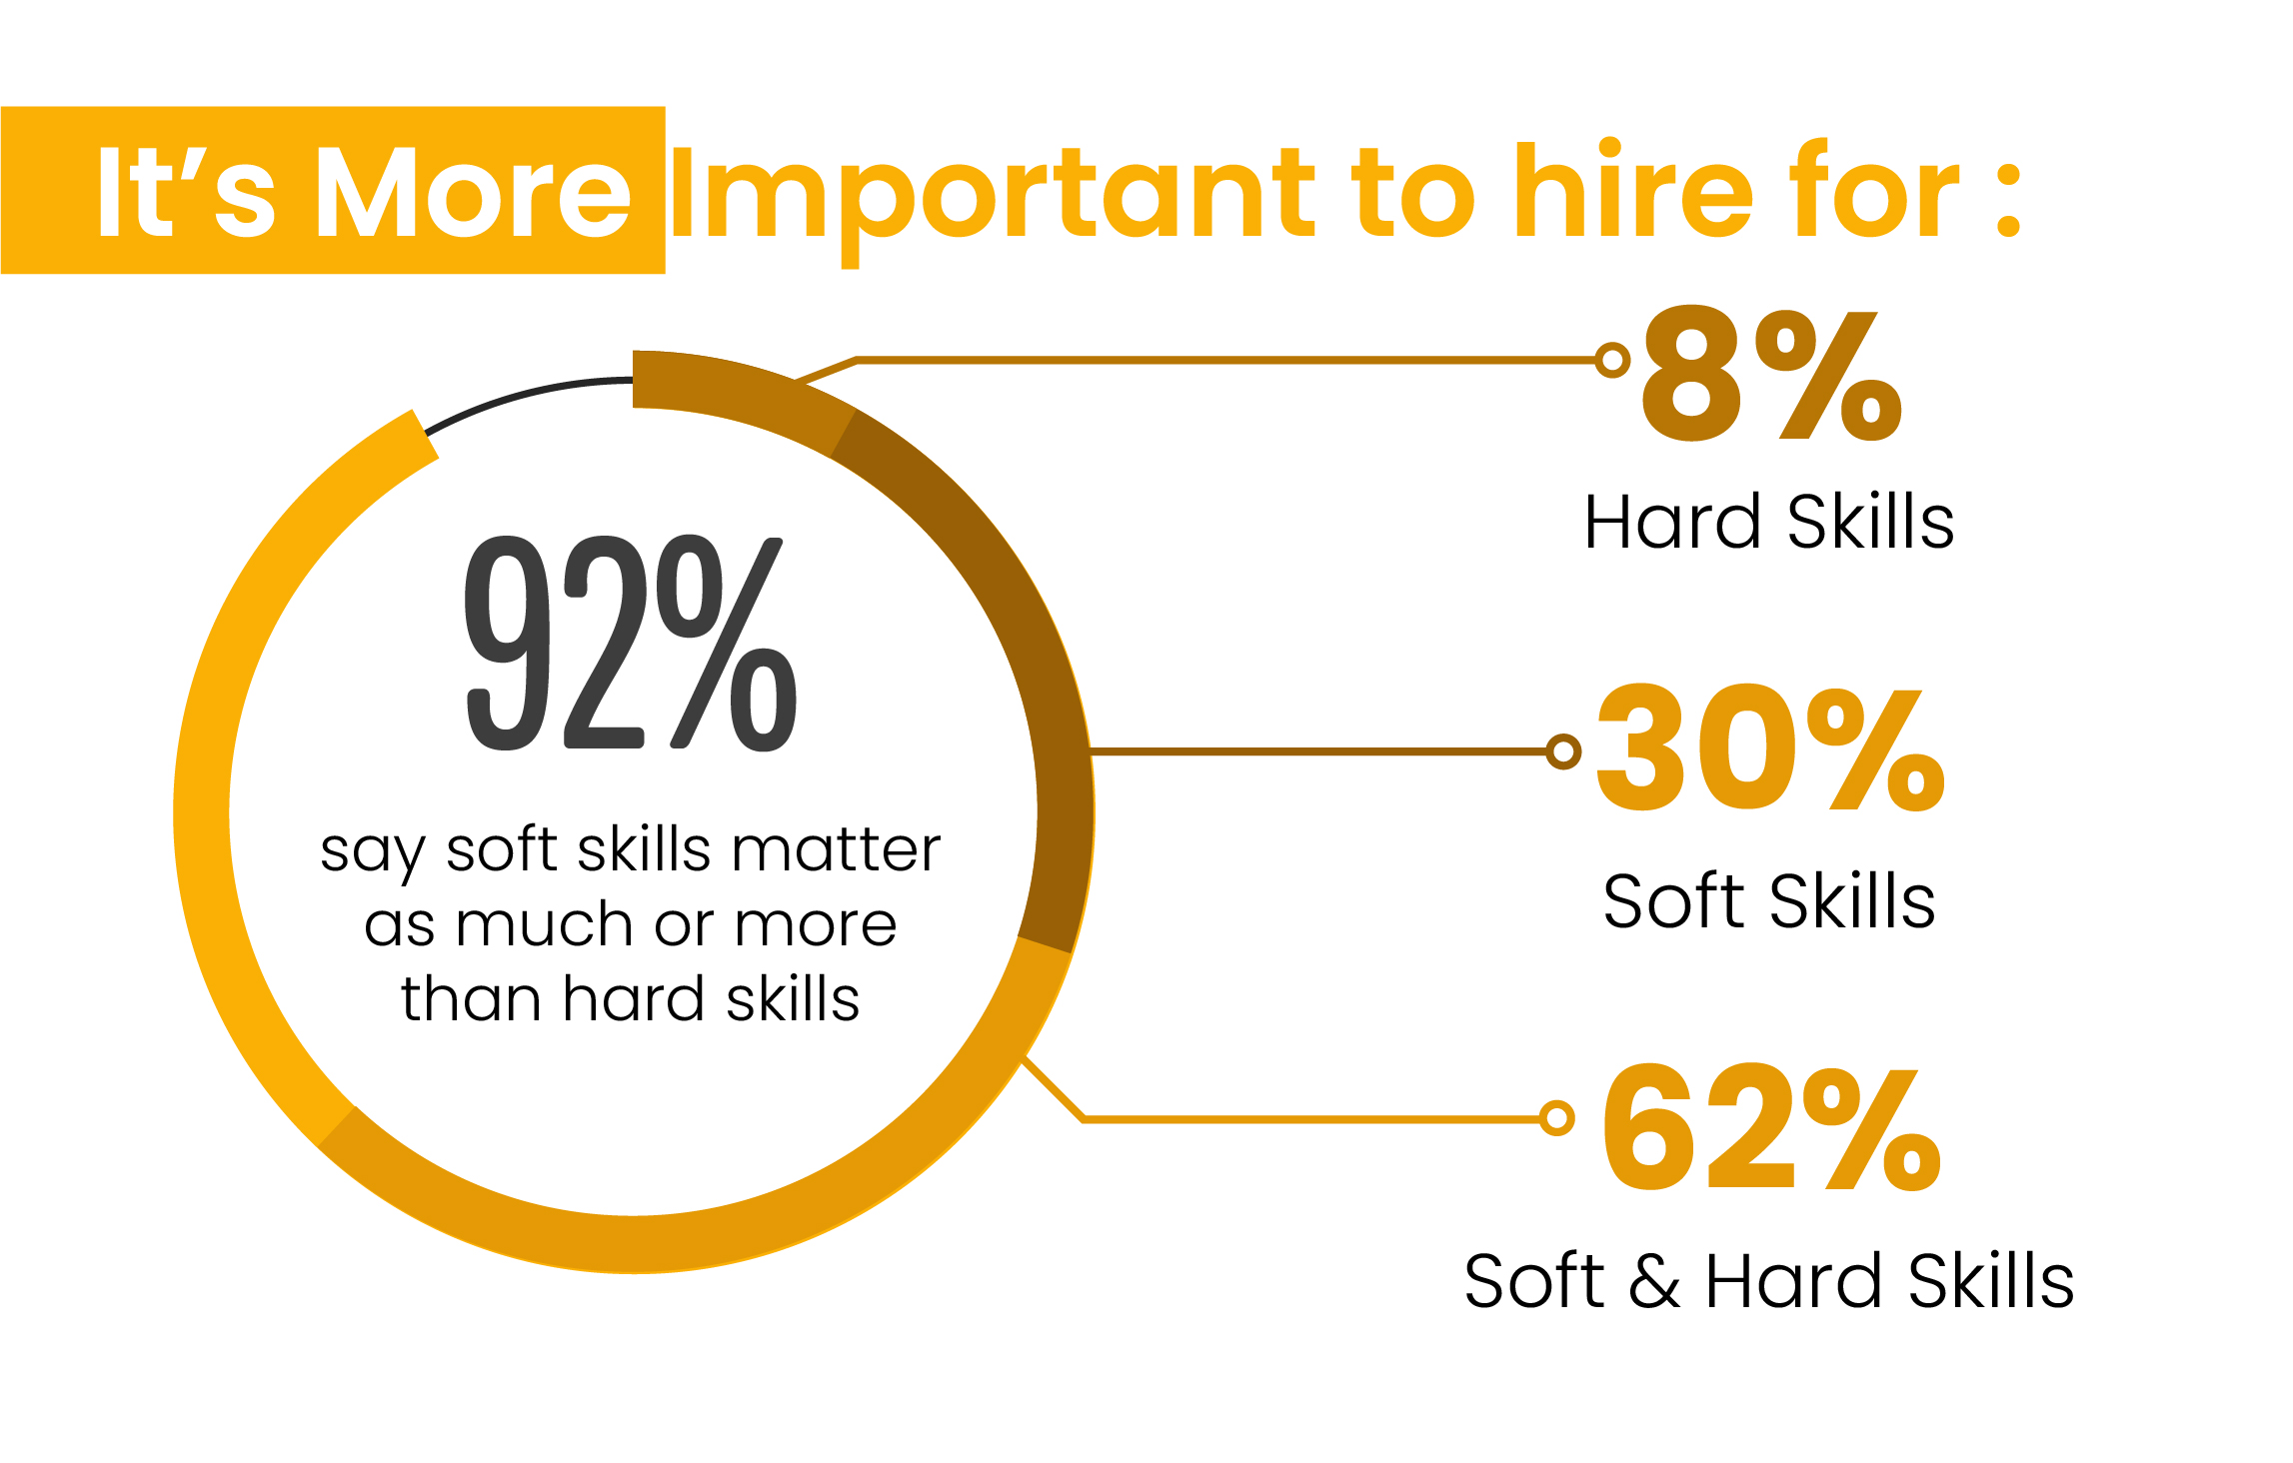

Slide 6
What is grooming ?
Taking care of your body and personal hygiene to maintain a pleasing professional physical appearance.
Importance of grooming
Proper grooming and professional appearance are important to gain not just a positive impression but also respect in the workplace.
First impressions matter and the way employees look and carry themselves create impact with customers, and potential clients.

Slide 7
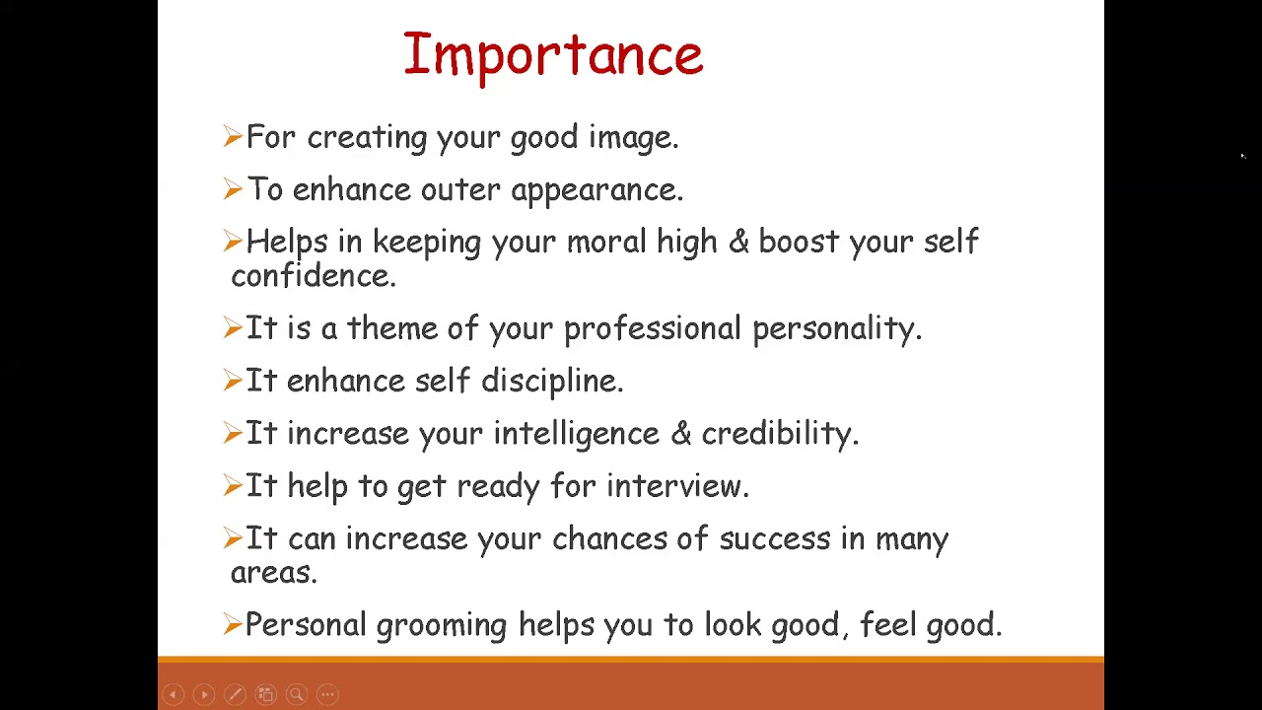

Slide 8




Interpersonal communication
“
”
The Communication between two or more people.
Exchange of messages, ideas, and information between individuals.
E.G.: face-to-face conversations, phone calls, emails, and video conferences.

Slide 9

adaptability
the quality or tendency of being able to adjust to new conditions

Slide 10


Slide 11





Importance of time management
Reducing stress
Prioritizing what's important
Achieving goals more efficiently
Accomplishing more in less time
Getting further in your career or education

Slide 12
TIMELINE
SEP 20XX
NOV 20XX
JAN 20XX
MAR 20XX
MAY 20XX
Synergize scalable e-commerce
Disseminate standardized metrics
Coordinate e- business applications
Foster holistically superior methodologies
Deploy strategic networks with compelling e- business needs

Slide 13

Teamwork
“the combined action of a group, especially when effective and efficient”.

Slide 14



HOW WE GET THERE
Teamwork unites people
Teamwork promotes efficiency
Teamwork fosters a learning environment
Better opportunities for feedback
Teamwork helps in resolving issues faster
More Fun
Less Stress
More fun
More communication
Less confusion
More creativity
Less fear
More personal growth
Less burnout
More motivation
More diversity
More relationship-building
More resilience

Slide 15
SUMMARY
What is your Takeaway ?
Recognize industry needs and develop professional ethics.

Slide 16
THANK YOU
Reach Out to Me:
Mr. Kartikain Shivam
Kartikain.30819@lpu.co.in

